Slide 1
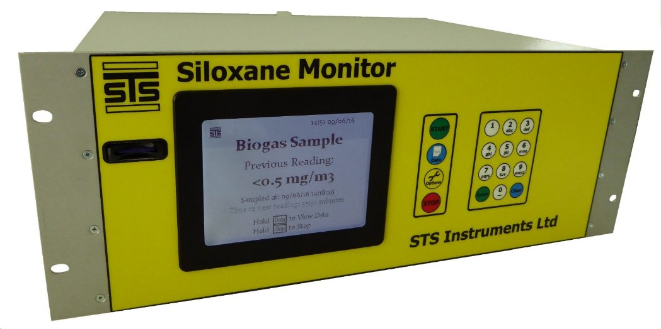
STS SILOXANE MONITOR
The STS Siloxane Monitor demonstrates that Carbon tower filter failure and regenerative processes can be identified, trended, and quantified.
The resultant data may be used to manage filter change regimes to potentially extend filter life, to optimise regenerative processes, and or, prevent engine damage from siloxane laden gas.

Slide 2
Instrument Design Approval
The Siloxane monitor is CE marked and has been designed and built to satisfy the IGE SR25 criteria.
1) Without prejudice GTS have examined the amended equipment specifications against Southern Water requirements and current industry gas legislation, standards, codes of practice & technical guidance documents. 2) GTS can to the best of our knowledge see no reason that this specific equipment cannot be installed on bio-gas installations to monitor gas qualities as contraventions to the above documentations are not apparent. 3) Therefore providing the equipment is installed and maintained by a suitably competent gas safe registered engineer and in accordance with the documentation within paragraph (1) above GTS will grant independent approval. Kind regards Craig Hunt Gas Training Solutions Wetherby Road Derby DE232QH

Slide 3
Instrument Safety Design
Constant air purging of in excess of 6 times the instrument volume/min will purge in excess of a worst case scenario internal leak
Kiosk inlet regulated to 35mbar max
End of line flame/detonation arrestor
Instrument inlet valve powered open- Safe shut downs closes inlet valve, turns off all heaters, power outage automatically triggers inlet valve to shut.
Onboard methane sensor triggering safe shut down at 10% LEL
Onboard Temperature sensor triggering safe shutdown at temp in excess of 50C
Purge fans monitored triggering safe shutdown if not running
Internal gas volume less than 200ml at any time
Internal pipework in SS with bore of <1mm

Slide 4
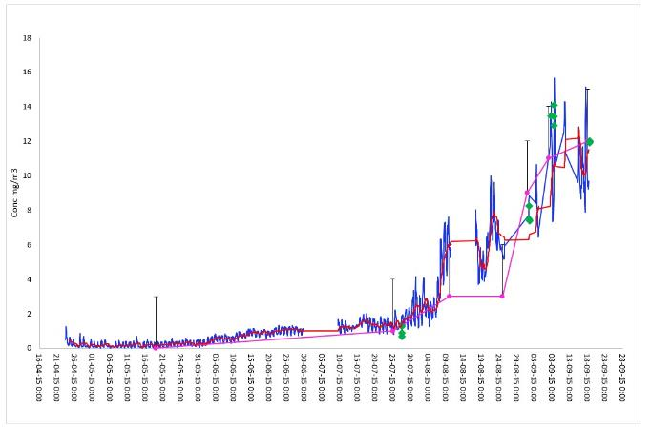
Instrument Specification
NDIR detection with Gas Chromatography
Unique sample concentration media
Performance - detection limit of 0.5mg/m³ total siloxanes.
Rate of measurement – a result is produced every ~60 minutes under standard settings
Biogas consumption - 1200 mls are required for every 60 minute cycle.
Weight - 12 Kg, Dimensions - 475 x 170 x 350 mm
Enclosure - painted steel, with aluminium front panel.
Large clear LCD screen and single piece membrane
Low ongoing cost of ownership

Slide 5
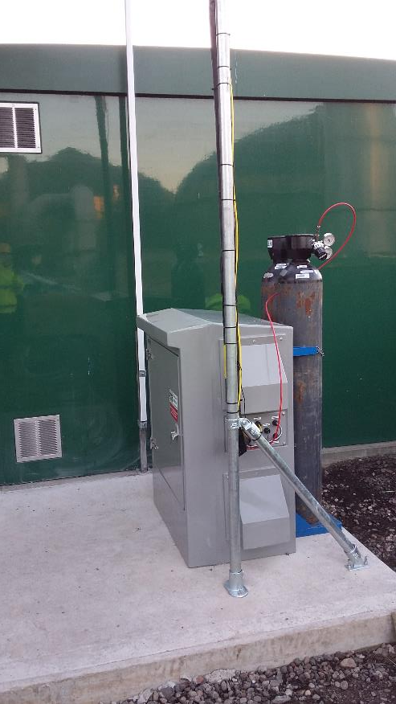
Requirements
Power – 110V, 6A Instrument, 16A for heated line 9A for cabinet heater
Nitrogen instrument grade, consumption 100 mls/min
– a standard X47S cylinder lasts about 80 days.
Non condensing biogas supply
(a water trap and coalescing filter are supplied in kiosk)
Vent position
Water trap drain point
Hardstanding for kiosk
Cage/anchor for Nitrogen cylinder(s)
Mast for telemetry Aerial/Vent
¼” sampling points on pre and post filter lines

Slide 6
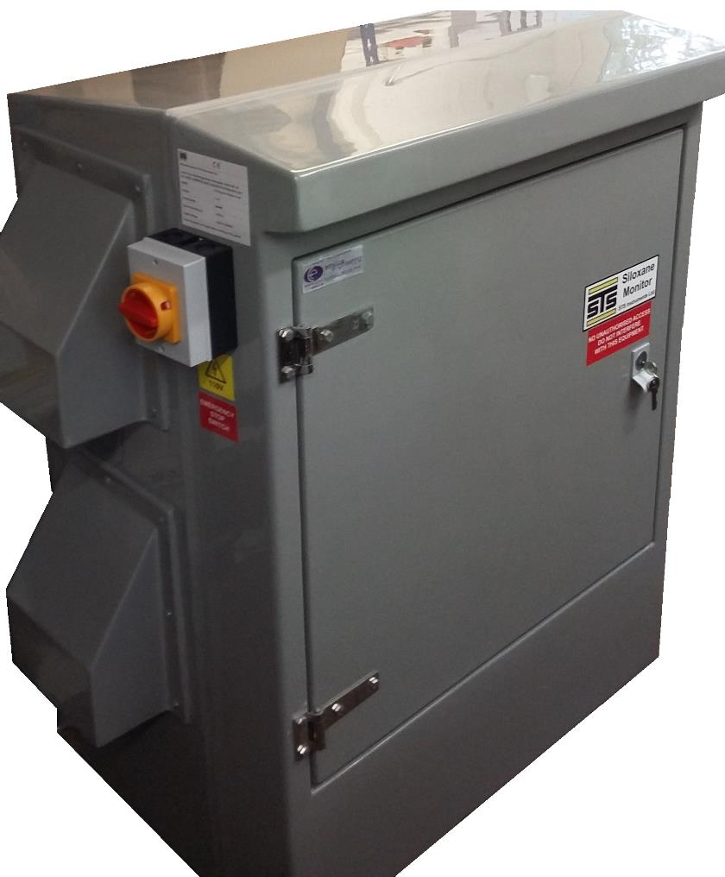
Kiosk
GRP IP rated cabinet
Pre-assembled and equipped ready for connections
Gland plate pre made
Shut off valves on each incoming Biogas line
Autodrain Water trap
Coalescing Filter
Flame Arrrestor
Cabinet Heater
Cooling Fan
Heated Line Thermostat/Junction Box
External Kill Switch
Internal Power Distribution board with RCDs for 6A,16A and 9A
Ancillary control box – controls Solenoid valves & water trap
Telemetry Box(externally Located).

Slide 7
Competitive Advantages
Integrated pre configured packages
Control over maintenance costs
Reduced down time & Overhead
Carbon replacement prediction and control
Maximisation of maintenance efficiency

Slide 8
Carbon and Regenerative Filters

Slide 9
TYPICAL SEWAGE WORKS CARBON FILTER SATURATION

Slide 13
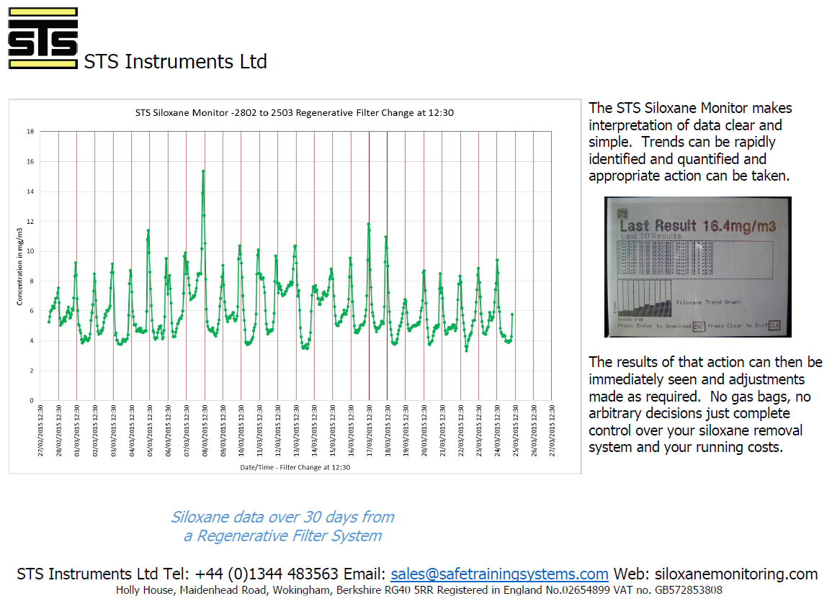

Slide 14
Landfill Example

Slide 17
Data Management

Slide 18
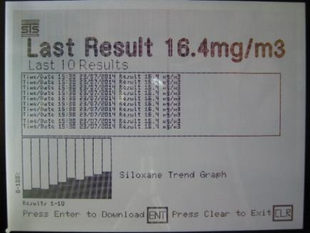
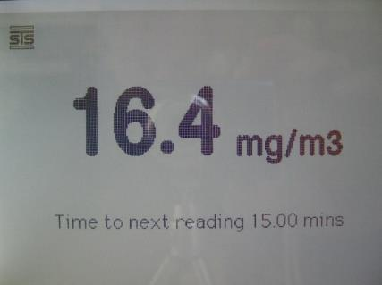
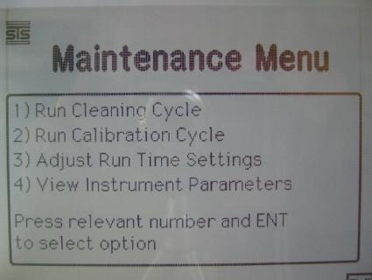
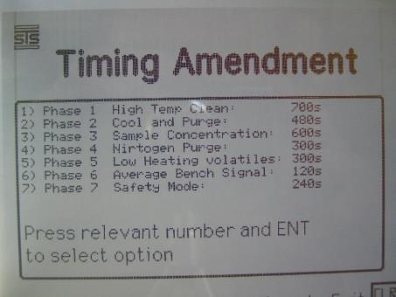
User Interface Screens
Data Screen – Displays historical data and trend information without the requirement to download data for analysis
Default -Home Screen displays last reading and time until next reading
Maintenance menu options allows approved users to make adjustments to the operational parameters of the instrument (locked to other users)
Each phase can be adjusted to suit a particular site requirement – and to enable lower (or higher) levels of detection depending on the sites Siloxane loading in the Biogas feed.

Slide 20
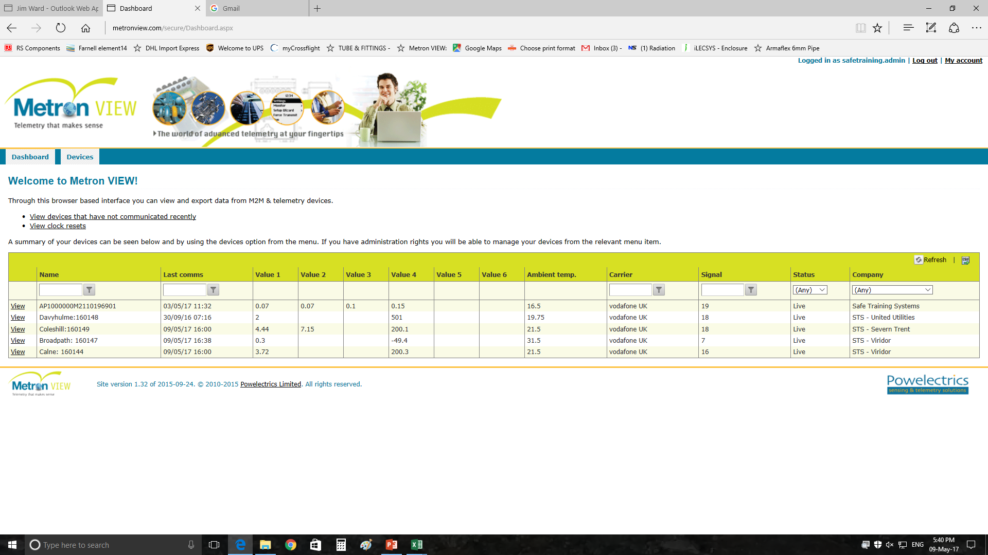

Slide 21
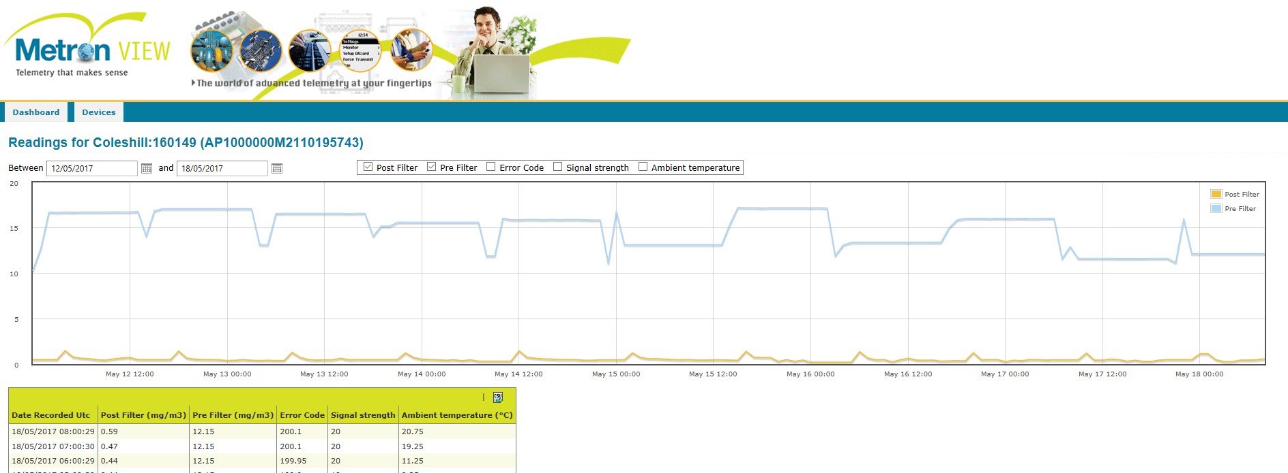

Slide 24
For Further information on the STS Siloxane Monitor please contact Jim at:
STS Instruments Ltd
Holly House
Maidenhead Road
Wokingham
RG40 5RR
+44 (0) 1344 483563 or 07887 518725
jim@safetrainingsystems.com
www.siloxanemonitoring.com

